Slide 1


Proposal for Transition to Non-Relational Database
All T20 Internationals Dataset (2005 - 2023)
Avinash Bunga
Information Systems and Business Analytics, Park University CIS622DLAF2P2023
Data Architecture for Business Analytics Professor: Gulnoza Khakimova
Unit 8: Discussion - Dec 6, 2023

Slide 2

Welcome to Our Data Evolution Journey
Presentation Purpose
Proposal for transitioning to a non-relational database framework.
Agenda Overview
Current relational database setup
Pros and Cons of adopting a non-relational system
Tailored recommendation for this strategic shift

Slide 3
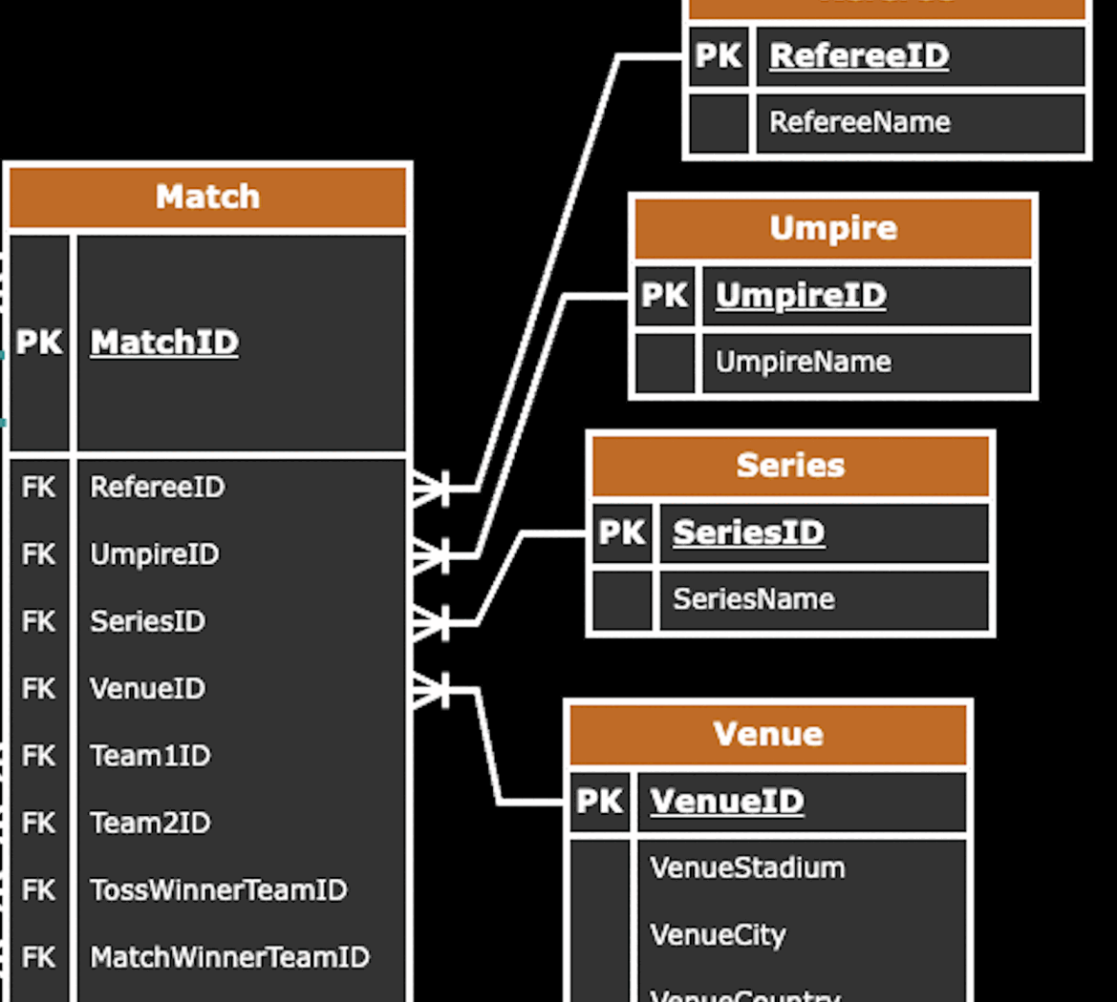
"All T20 Internationals Dataset" Framework
All_T20_Internationals_Dataset_2005_2023
Purpose of the Database: To maintain a comprehensive record of all T20 International cricket matches played between 2005 and 2023
Core Components: 12 tables.
Data Relationships
Interconnected using a Primary Key (PK)
linked to other tables through Foreign Keys (FK)
Snapshot Example
Player | Team
Match | Wicket
BattingCard | BowlingCard
MatchPlayers | TeamCaptain
Referee | Umpire
Series | Venue
Notes:
Database Summary

Slide 4
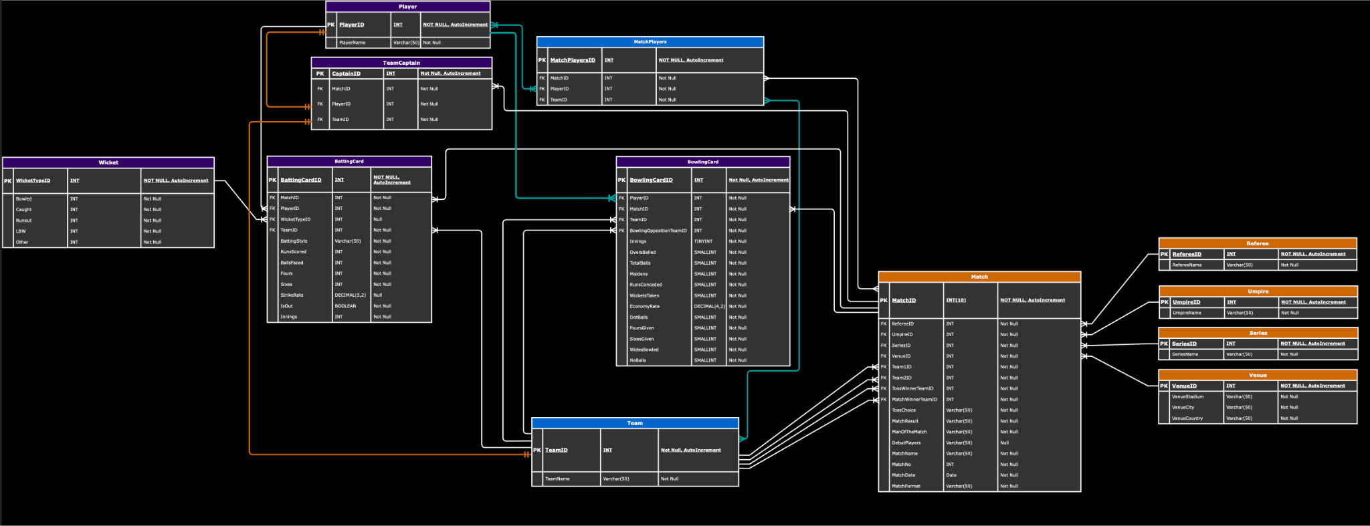
Physical Entity Relationship Diagram (ERD)
GitHub - Link

Slide 5


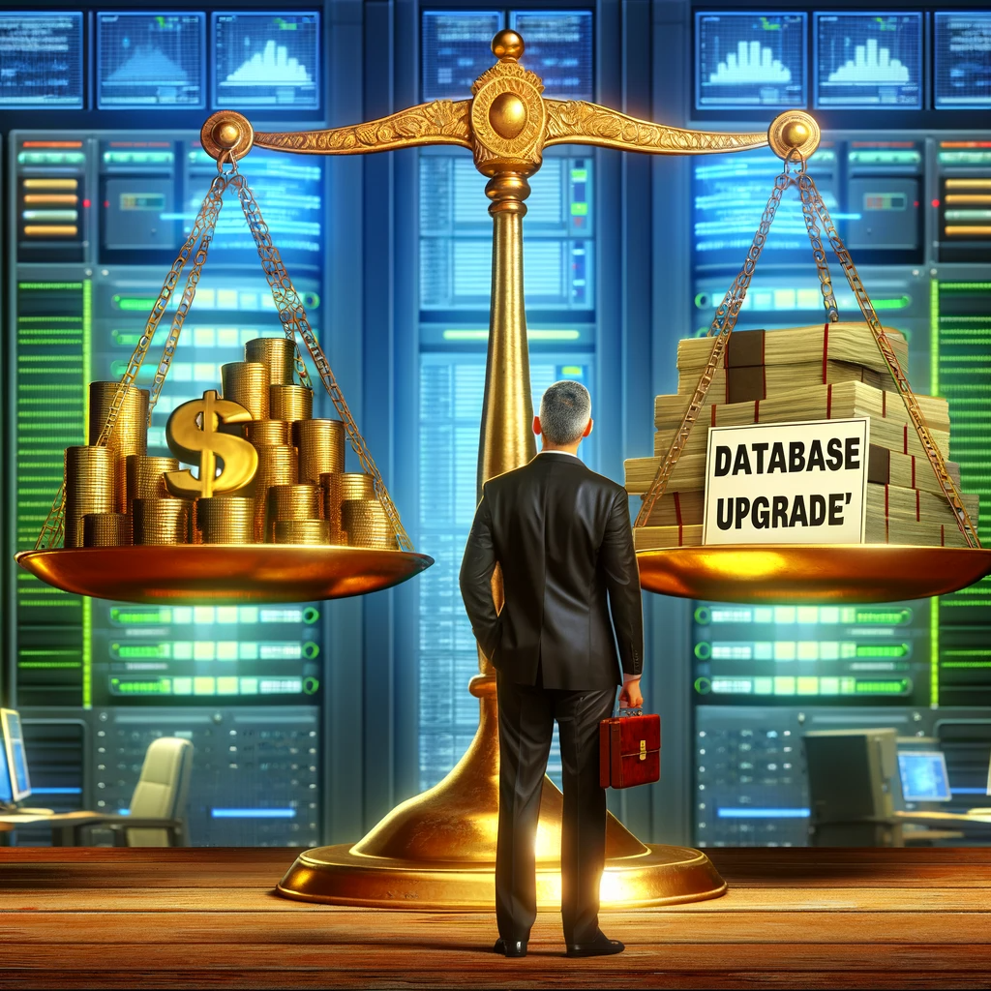
Limitations of Current System
Slow Performance
As the amount of data grows, the database can slow down
Hard to Change
Tough to make changes to the database structure if we need to store new types of data
Costly Upgrades
Growing our database can be expensive, requiring better hardware or software.

Slide 6



Limitations of Current System
Struggles with Varied Data
Our current system isn't the best at dealing with data like photos or social media posts.
Complex Relationships
Our relational database can get tangled with too many links between tables, making it hard to manage and understand
Rigid Schemas
Any new data type requires a redesign of the database schema, disrupt our operations.

Slide 7


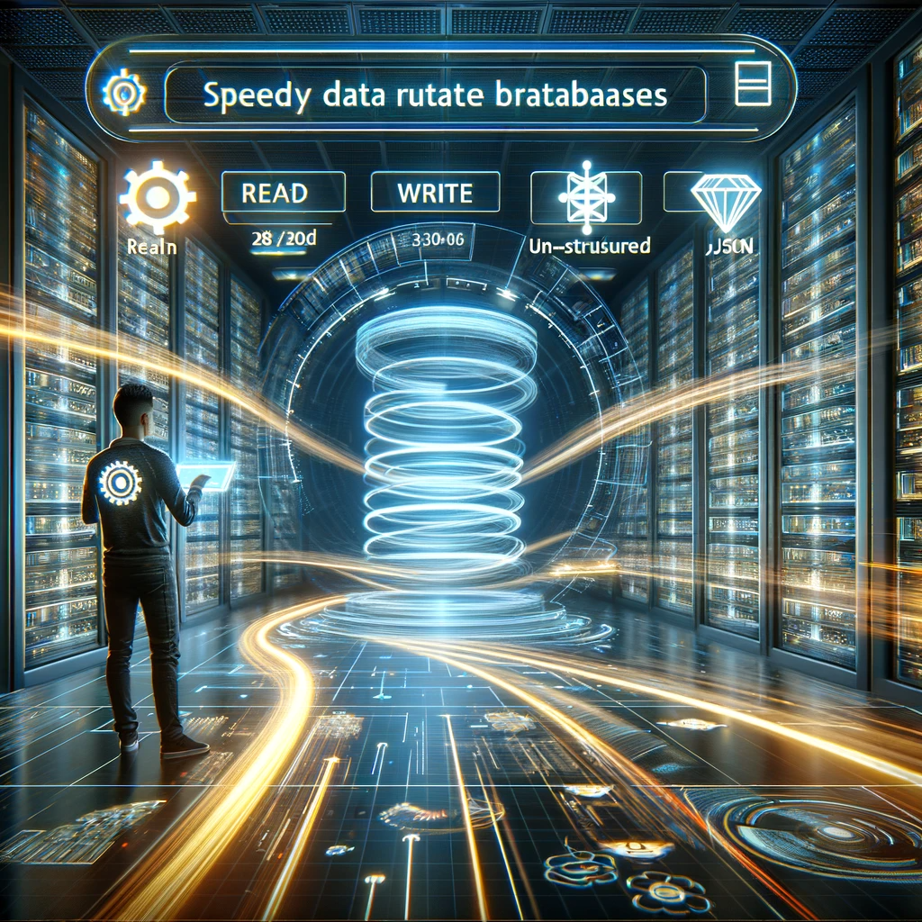
Pros - Switching to a non-relational database
Enhanced Flexibility
Don't require a fixed schema, allowing for the storage of diverse data types easily.
Improved Scalability
Designed for cloud integration, supporting horizontal scaling to handle large data volumes efficiently.
Speedy Data Retrieval:
Optimized for quick read/write operations, particularly for unstructured data like JSON - Improving performance.

Slide 8



Pros - Switching to a non-relational database
Cost-Effectiveness
Lower overhead and maintenance costs due to their schema-less nature and distributed architecture.
Real-time Processing
Offer real-time data processing capabilities, which is essential for analytics and big data applications.
Developer-Friendly
Provide APIs for easier and more intuitive data manipulation.

Slide 9



Cons - Switching to a non-relational database
Consistency Concerns
Non-relational databases may compromise on consistency for faster access, which can be a risk for data integrity.
Transactional Support
Handling complex transactions is often easier in relational databases due to their ACID compliance.
Learning Curve
Teams may need to learn new query languages and database concepts, which can slow initial progress.

Slide 10

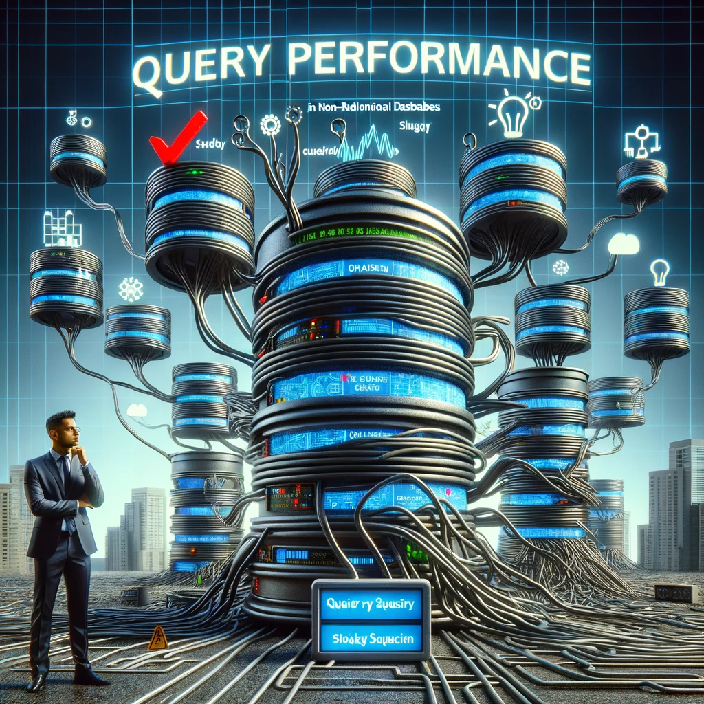

Cons - Switching to a non-relational database
Integration Issues
Integrating non-relational databases with existing applications that are designed for relational databases can be challenging
Query Performance
Complex queries can be less efficient in non-relational databases
Support and Community
Support community for non-relational databases may be smaller, making it harder to find solutions to problems

Slide 11



Recommendation: The Non-Relational Upgrade
Agility for Analytics
Rapid querying across vast datasets, a boon for T20 cricket analytics.
Rich Media Management:
Seamlessly handle diverse data types, from player stats to match images and videos.
Scalability for Growth
Effortlessly scale during high-traffic events like tournaments without compromising performance

Slide 12



Recommendation: The Non-Relational Upgrade
Live Event - Data Capture
Capturing and analyzing data from live matches, including commentary, player tracking, and audience interactions.
Machine Learning Readiness
Equip for AI with a database that simplifies the use of diverse data sets for predictive analysis and automated insights
Match Forecasting
Predictive analytics for sharper insights into T20 cricket trends.

Slide 13
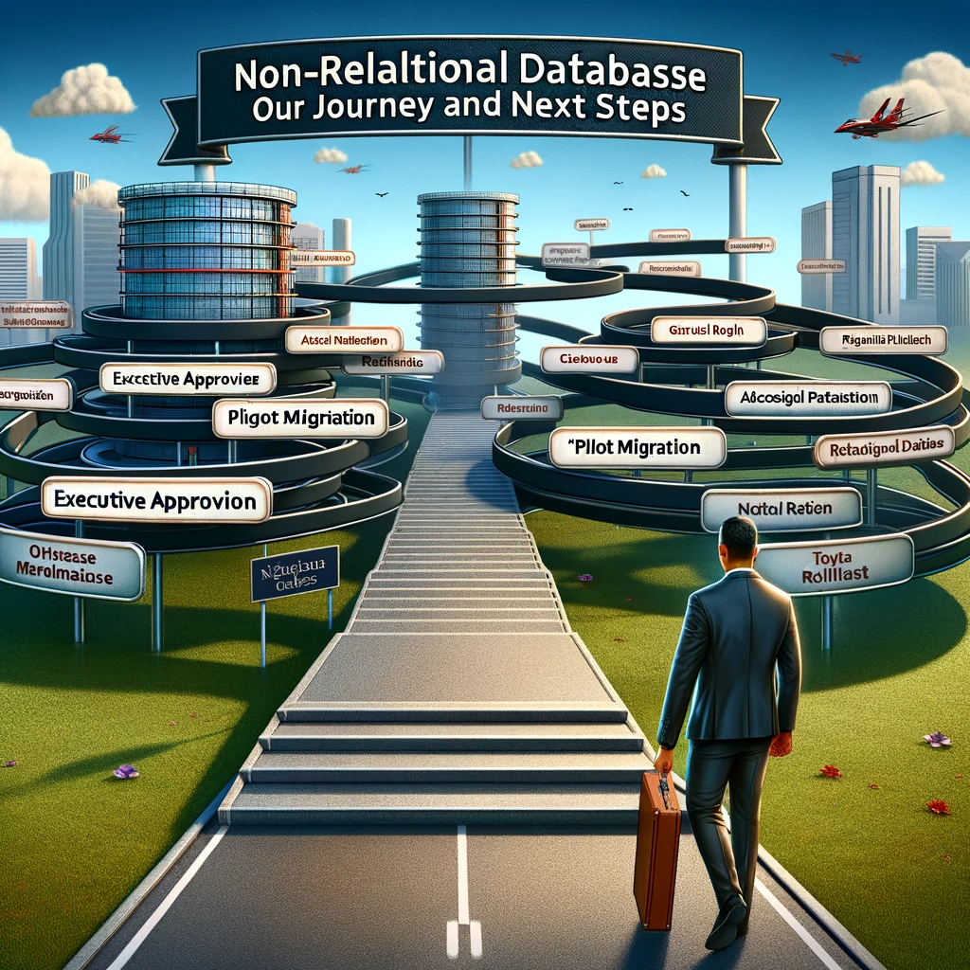
Conclusion - Towards a Data-Driven Future
Our Journey
Evaluated our current relational database's limitations
Explored the Pros and Cons of a non-relational system
Recommended a strategic shift to enhance our data analytics capabilities
Next Steps:
Executive approval for transition strategy
Initiate a pilot migration project
Gradual rollout with continuous evaluation

Slide 14
Q&A - Your Insights Matter
I'm eager to hear your thoughts and engage in fruitful discussions based on the peer reviews.
Let’s collaborate and refine our strategies towards a more dynamic data infrastructure.
Follow the ongoing project updates and connect for deeper insights on my GitHub: [YourGitHubLink]
I welcome your questions, critiques, and ideas to enhance our understanding and approach.

Slide 15

Thank You for Your Engagement
"Special thanks to our Professor, Gulnoza Khakimova for guiding our learning journey and paving the way for our progress."
"A heartfelt thank you to my classmates for the enriching discussions and shared learning experiences."

